Slide 1
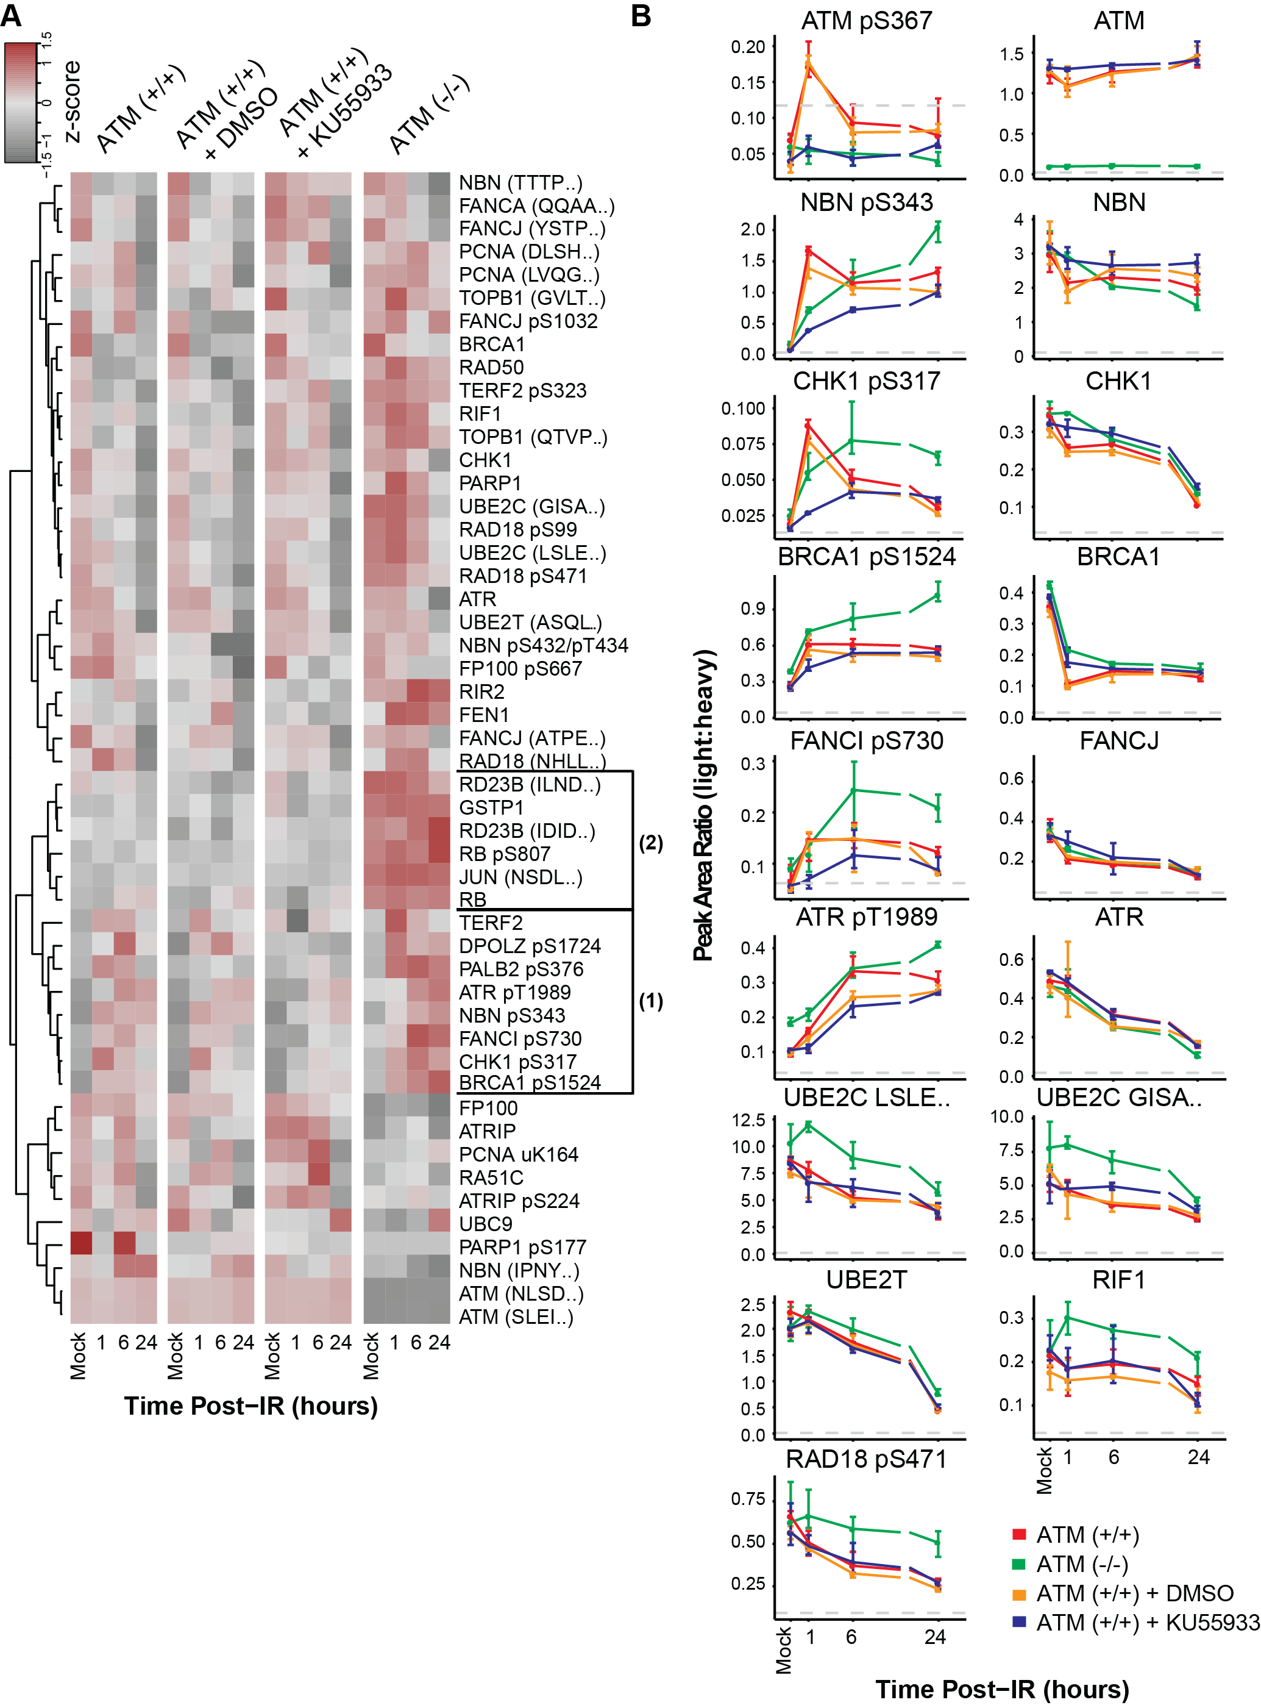
Heatmap unclustered.
Median of three replicates
Log2 transform
Blue-red heatmap
- ATMi
IR Dose (1hr)
0 1 2 5 10Gy
DMSO, 5Gy
Sample Label
Time post-IR
m 0.25 1 6 24hr
+ ATMi, 5Gy
Time post-IR
m 0.25 1 6 24hr
Peptide Label
Notes:
Peak area ratio normalized to median Log(2) transformed

Slide 2
Time-course plots for individual analytes.
Median of three replicates
Error bars +/- std dev
Notes:
Peak area ratio normalized to median Log(2) transformed

Slide 3
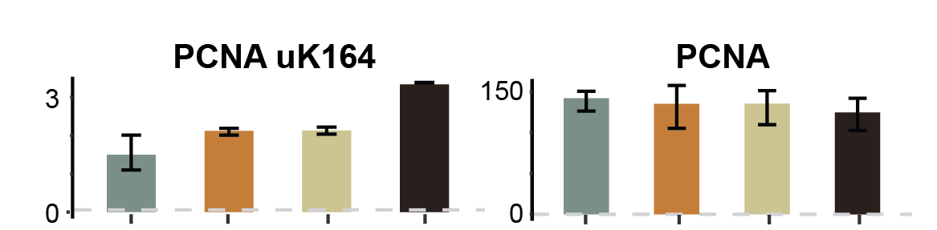
Dose-response plots for individual analytes.
Median of three replicates
Error bars +/- std dev
0 1 5 10 Gy
0 1 5 10 Gy
Notes:
Peak area ratio normalized to median Log(2) transformed

